Slide 1

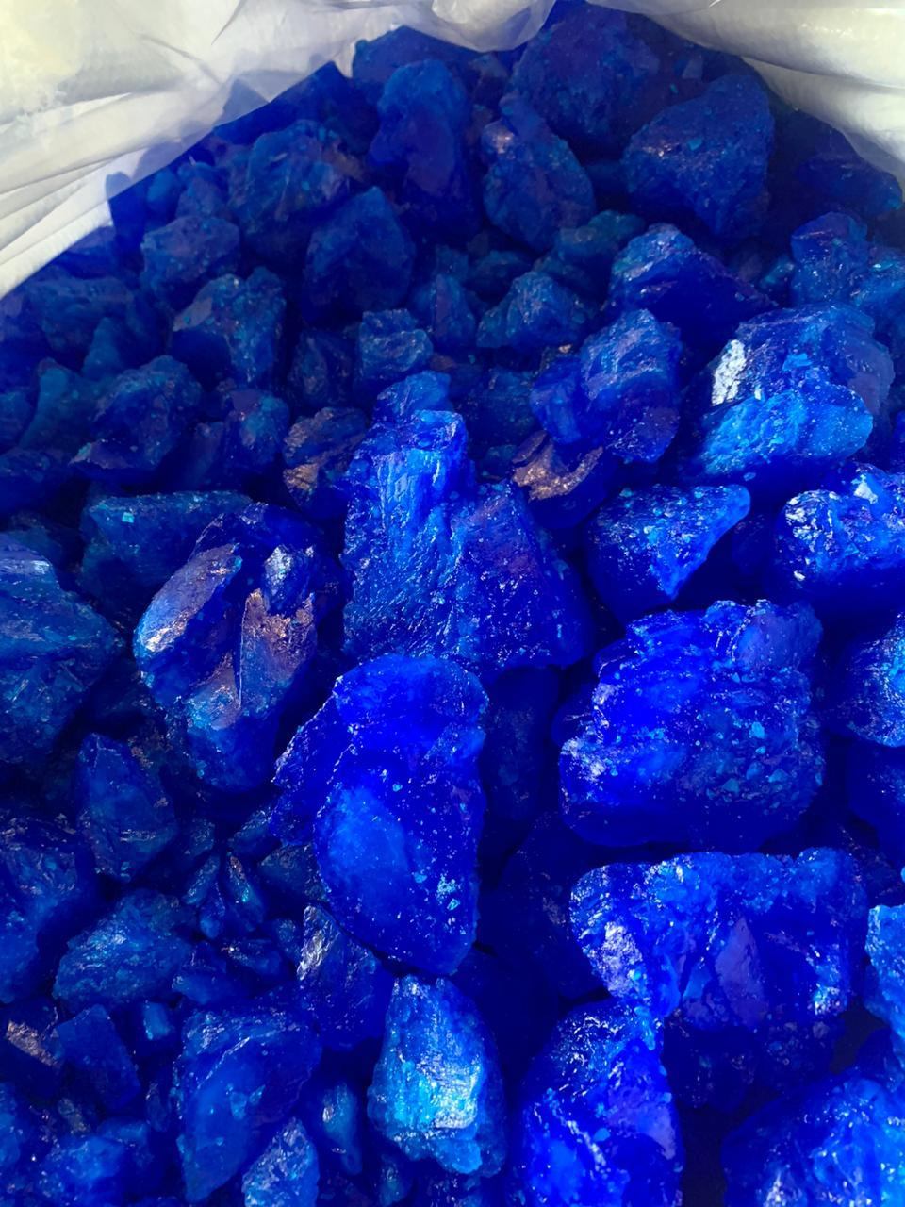

2016 – 2026
SOUTH-EAST ASIA COPPER SULPHATE MARKET
BY GRADE, BY END USE,
BY TYPE, BY COUNTRY,
BY COMPANY, COMPETITION, FORECAST & OPPORTUNITIES
MARKET INTELLIGENCE . CONSULTING
www.ChemAnalyst.com

Slide 2
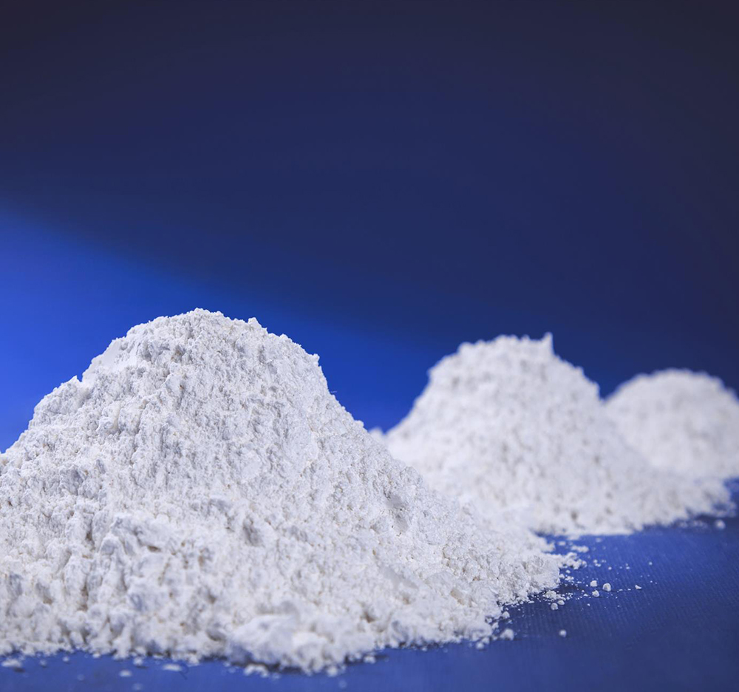
Scope of Report
Product of Interest (POI): Hydrate
Copper sulphate or CuSO4 in an inorganic compound that combines copper and sulphate. In the liquid or powdered form, it is commonly called basic copper sulphate, tri – basic copper sulphate, or CP basic sulphate. In the solid form, crystal shaped stone is formed which is commonly known as pentahydrate or blue stone or blue vitriol for its blue color. In the solid form, it is mostly used as a raw material for producing other copper salts. It is a multipurpose chemical with large number of uses in industries as it has in agriculture. Copper Sulphate is having its end use in major industries like agriculture and pharmaceutical industry. Besides, it also finds extensive applications in several other fields like coatings, adhesives & sealant industries, construction industry, chemical industry, and others. Due to its ideal properties, it is often used in the pharmaceutical industry as an anti-malaria agent, antiseptic and germicide against fungus infections.
Market Segmentation
Type
END USE
Hydrous
Anhydrous
Agriculture
Electricals
Chemicals
Medical
Electroplating
Leather and Textiles
Review Period
2016 – 2019
Base Year
2020
Estimated Year
2021
Forecast Period
2022 – 2026
Year Range
GRADE
Industrial Grade
Reagent Grade
COUNTRY
Philippines
Vietnam
Thailand
Indonesia
Malaysia

Slide 3

Market Dynamics

Slide 4

Drivers
Growing Agriculture Sector
Agriculture accounts for around 10% of Southeast Asia’s GDP as of 2020. Government across Southeast Asian countries such as in Indonesia and others is focusing on increasing agriculture infrastructure (such as irrigation facilities, warehousing and cold storage) to obtain higher yields. This is expected to boost demand for copper sulphate being used as a fertilizers as it effectively helps in preventing fungus, algae and other unwanted microorganisms as well as helps in improving the quality of soil.
Positive Impact of GST on Fertilizers
Goods Service Tax has impacted the manufacturers of fertilizers in a positive manner. Now, they are entitled to pay 5% of tax whereas before GST, manufacturers were paying 5% of VAT along with 1% of excise duty. With this move, it is anticipated that in the near term, the indigenous fertilizers market would be benefitted. This would further boost the copper sulphate consumption across the Southeast Asian countries.
Southeast Asia Fertilizer Usage Kg per Hectare of Arable Land, By Country, 2017-2019
2016
2017
2018
2019
Source: Ministry of Agriculture & Farmers Welfare

Slide 5
Drivers
Limited Availability of Arable Land and High Demand for Fertilizers in Emerging Nations
Rising urbanization and industrialization are leading to the shrinkage of available arable land across the Southeast Asia. In order to increase yield and overall productivity, farmers use large quantities of fertilizers that not only prevent unwanted microorganisms, but also enhance soil quality. According to Food and Agriculture Organization (FAO), despite slow population and agriculture sector growth across Indonesia, Thailand and others, food production would continue to grow in the coming years across these countries. As arable farming land is continuously shrinking and it would be very difficult to supply food to the growing population, farmers across all geographies are using large quantities of copper sulphate as fertilizers in order to maximize yield per unit area.
Farmers in emerging countries across the region are often confronted with issues related to providing optimal nutrients to plants, in a cost-effective manner. Factors driving the copper sulphate market in the emerging markets include increasing demand for high quality fertilizers, increasing per capita income, rising farming standards, growing population, and extensive R&D for development of high-quality fertilizers. Major emerging countries in the copper sulphate fertilizers market include Indonesia, Thailand, Malaysia, among others. Emerging markets present tremendous untapped growth potential for new as well as existing market players.
Southeast Asia Share of Arable Land (% of total land area), 2018 & 2020

Slide 6
Challenges
Threat from Product Substitution/Technology Development
Zinc Sulphate is moving into some markets that is currently occupied by copper sulphate, especially in agricultural applications. Zinc Sulphate being comparatively less toxic than copper sulphate as copper becomes toxic to animals due to skin absorption. Along with and economical protection, cost effectiveness also plays an important role in choosing the right fertilizer.

Slide 7
Market Trends & Developments

Slide 8
Trends & Developments
Escalating demand for Animal Feed
In order to address the ever-growing demand for food, animal husbandry have been observed significant growth in recent years. This is directly driving the copper sulphate across Southeast Asia which is widely used in animal feed as a basic nutritional supplement to treat copper deficiency in livestock. It is being added in animal’s diet in salt and other animal licks which mainly helps in fattening of pigs and broiler chickens by stimulation appetite. It is being consumed widely in many countries like Indonesia, Vietnam and others across the Southeast Asia as it also offers the lesser requirement of copper ions dosage by nearly 60% and hence significantly reduce cost as well as poisonous effects associated with copper ions. This will further drive the consumption of copper sulphate in coming years following surge in population and food demand.
Market Penetration
Companies are focusing on expanding their market reach and penetration across various countries across Southeast Asia due to strong competition from other players. Further, companies are offering lucrative incentives and schemes to dealers and distributors to boost their product sales. For instance, five percent cash discount is given to dealers on the marked dealer price coupled with several other offers derived for the dealers and stockiest varying from region to region. Companies are pushing their products by giving complete solution to end users, which include product cost, labor cost etc, which aids companies to develop their eco system of products as well as distribution. For example, Buildmore Enterprise Co. Ltd., one of the leading copper sulphate manufacturer also started the distribution of Cargill's raw materials for food and supplements in 2020.

Slide 9
Trends & Developments
Widespread Adoption of Organic Farming
Organic farming depends on sustainable techniques to enhance soil fertility and crop yield. Organic farming uses crop rotations, crop residues, animal manure, off-farm organic waste, mineral grade rock additives and biological system of nutrient mobilization and plant protection.
As of 2020, the area under organic agriculture across the Asia was about 6.2 million hectares which Philippines holding the largest share of nearly 72% followed by Vietnam and Thailand with anticipated higher growth across these countries in forthcoming years. Additionally, the Institute for Sustainable Agricultural Communities (ISAC) of Thailand encouraging organic farming in the country which is expected to reach 208,000 hectares by 2022.
Consequently, growing interest in organic farming, which utilizes organic nutrients to ensure high yields and maintain soil health also consume copper sulphate as an essential fungicide backed by its ability to kill fungi, algae and other pests via their membrane disruption. All these factors are expected to support growth of copper sulphate across different farming techniques and methods in the region.
Agricultural Land Under Organic Farming, By Country, Hectares
Source: Research Institute of Organic Agriculture (FiBL)

Slide 10
Trends & Developments
Volatility in Raw Material Prices
The prices of copper sulphate experiencing fluctuations in recent years as it is highly dependent on the price trend of sulphuric acid. Sulphuric Acid is the major raw material used for the manufacturing copper sulphate along with copper oxide. This, fluctuation observed recently due to COVID-19 pandemic across Southeast Asia and worldwide impacted prices of copper sulphate significantly and fertilizer industry as well. Thus, shifts in the feedstock prices affects the gross margin for copper sulphate manufacturers, thereby limiting the growth of this industry in the region.
Southeast Asia Sulphuric Acid Pricing Analysis (USD/Tons), 2015-2030F
Source: The World Bank

Slide 11

Strategic Recommendations

Slide 12

Emphasize on Sulphate Fertilizers
Sulphate fertilizers contributed around 82% share in volume terms, in 2019 in North America sulphur fertilizers market.
Ample availability of sulphate fertilizers such as ammonium sulphate due to presence of various caprolactum and steel units has boosted the consumption of sulphate fertilizers among other sulphur fertilizers.
Presence of high sulphur content in the sulphate form makes it readily absorbable for plants. Additionally, sulphate fertilizers have low pH, making them suitable for alkaline soils. As a nitrogenous fertilizer, ammonium sulphate fertilizer competes with urea, ammonium phosphates, and ammonium nitrate. Stability in the prices of ammonium sulphate fertilizer has also increased its sales in North America. Moreover, it has been observed that liquid thiosulphate fertilizers have also gained traction in the region.
Thus, sulphur fertilizer companies are recommended to focus on production of sulphate fertilizers in order to maintain strong presence in the market.

Slide 13
Target Country – United States
United States dominated North America sulphur fertilizers market with share of 58.39%, in volume terms, in 2019. High availability of arable land in the country has made it one of the leading crops producers and food exporters in the region, thereby generating huge demand for sulphur fertilizers in the country. Despite having a smaller workforce, agricultural sector in the United States holds significant share across the globe. California, Minnesota, Illinois, etc., are some of the states which generate high revenues from crop sales.
Currently, three - fourth of the US population is consuming food that is low in vegetables, fruits and oils. Shifting preference for customized diets and eating patterns has generated demand for protein meals in the country. Moreover, US food industry employs soy protein as a primary ingredient in production of food such as bread, tomato soup, etc. These factors have resulted in increased soybean production, which is further anticipated to escalate the growth of sulphur fertilizers market in the US.
Hence, sulphur fertilizer companies are recommended to increase their focus on United States in order to tap the emerging opportunities in the market.

